Slide 1
Gowin FPGA Boards

Slide 2
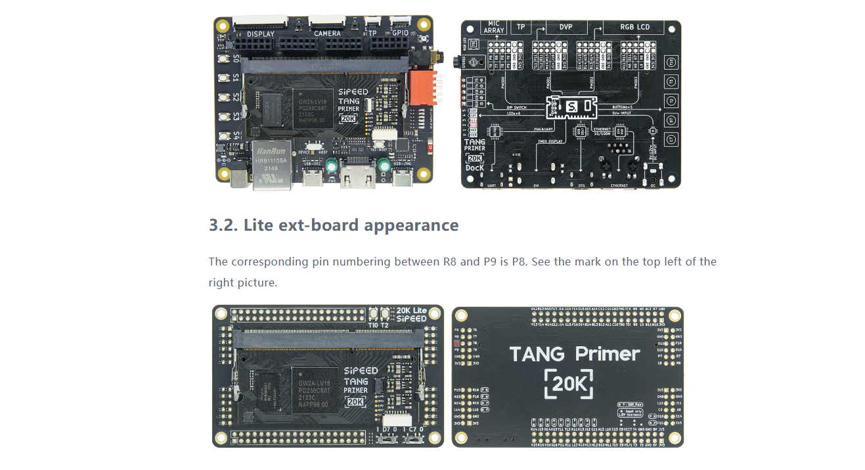
https://wiki.sipeed.com/hardware/en/tang/tang-primer-20k/primer-20k.html
https://wiki.sipeed.com/hardware/en/tang/tang-primer-20k/examples/led.html

Slide 3
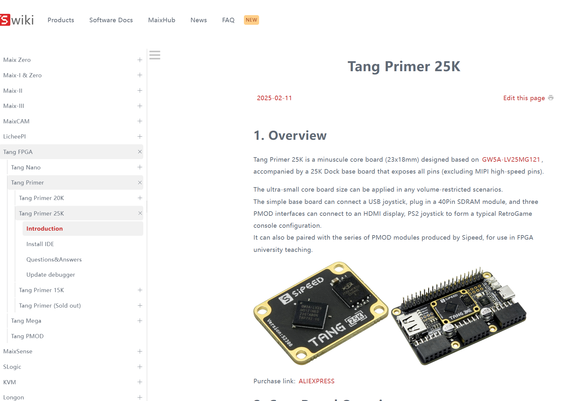
https://wiki.sipeed.com/hardware/en/tang/tang-primer-25k/primer-25k.html

Slide 4
gowin FPGA design under linux(ubuntu) :
https://git.tongji.edu.cn/ichip/doc/-/blob/main/env/hw_toolchain_guide.md
https://git.tongji.edu.cn/ichip/doc/-/tree/main
Gowin official website:
https://www.gowinsemi.com/en/support/home/

Slide 5
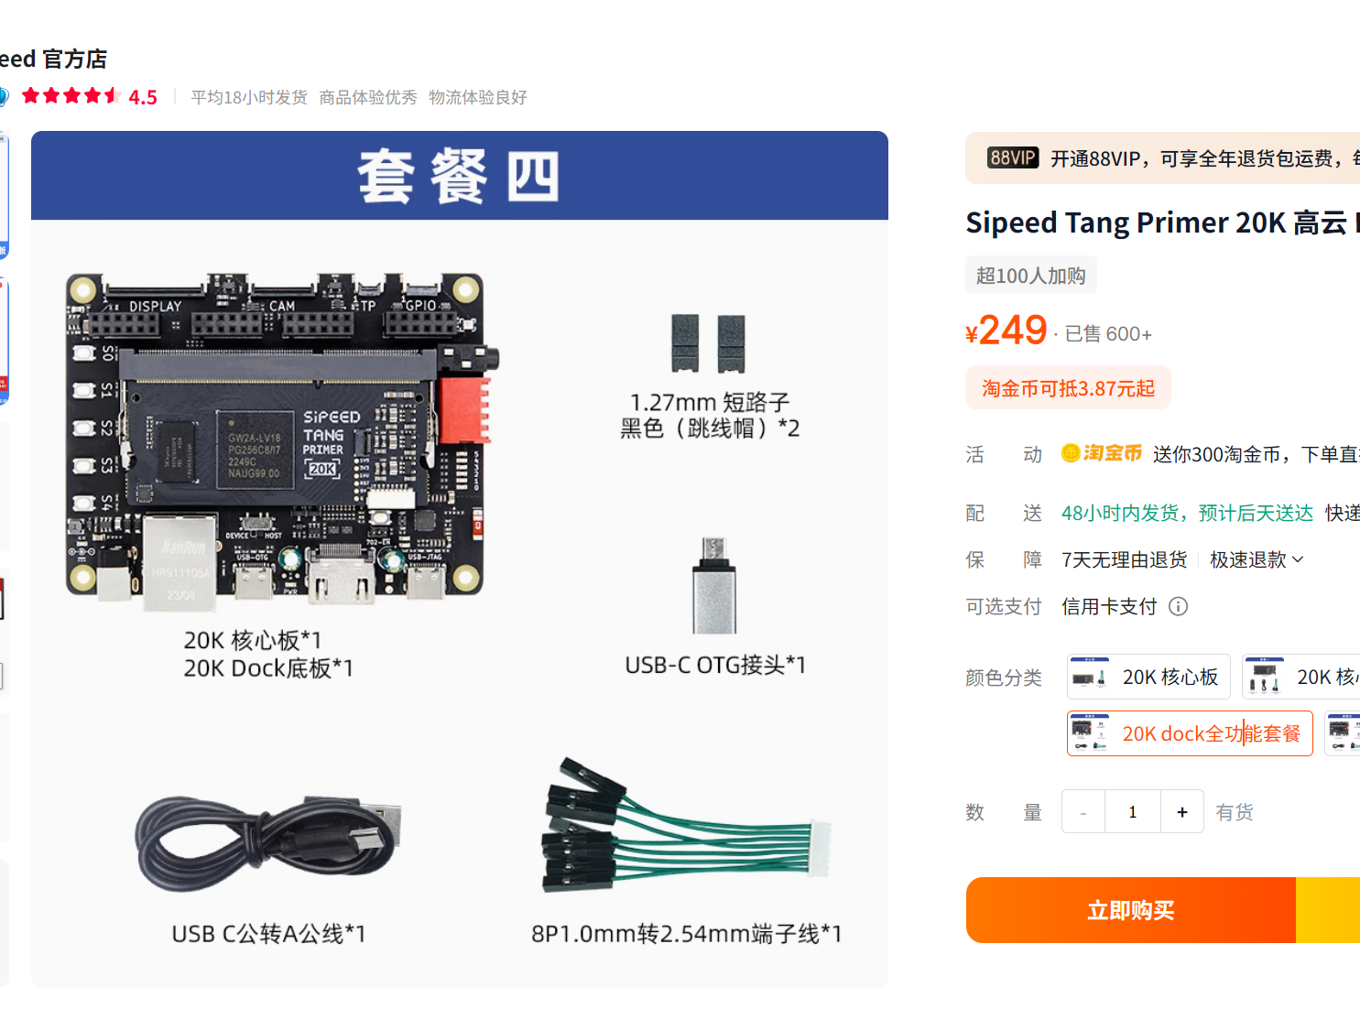

Slide 6
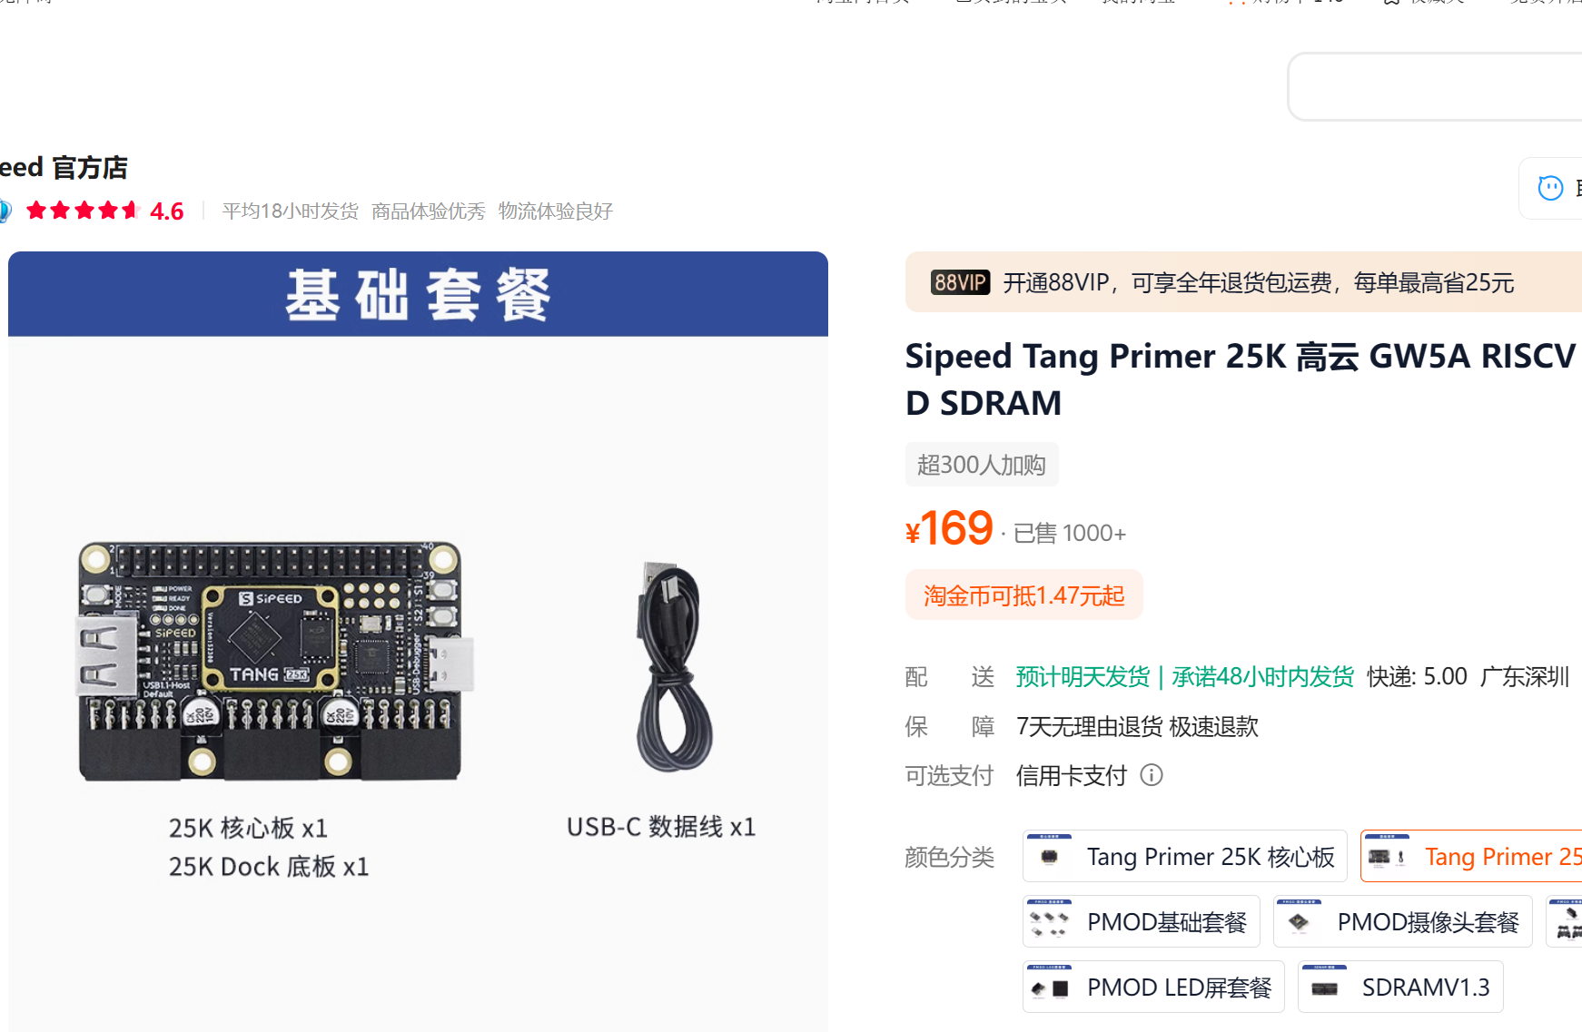

Slide 7


Slide 8

